Slide 1
HoopFinder
Iteration 3

Slide 2
Iteration 3 Overview.
Tasks from Iteration 2:
User login
Gmail Authentication enabled in Firebase and created new user
List of courts are stored in Firebase DB
Planned tasks for Iteration 3:
User signup information viewable on firebase console
Storing user location in Firebase DB
Unit testing for Facebook login
Unit testing for user location visibility and triggering push notification

Slide 3
Completed Use cases
Completed user stories:
User can receive text notifications when near a court location
Retrieving user phone number from Firebase.
User stories in progress:
User can view nearby court locations.
Pull data from DB and display to the user.

Slide 4
Metrics
 | 0 | 1 | 2 | 3 | 4 | 5
# hours worked | 15 | 25 | 53 | 22* | - | -
# defects | 0 | 0 | 2 | 2 | - | -
# lines of code | 0 | 34 | 479 | 675 | - | -
# user stories added | 0 | 1 | 2 | - | - | -
# class files | 0 | 3 | 6 | 7 | - | -

Slide 5
Issues
Need to finalize the storyboard for the remaining pages
Application getting crashed when its showing current location in emulator

Slide 6
Demo

Slide 7
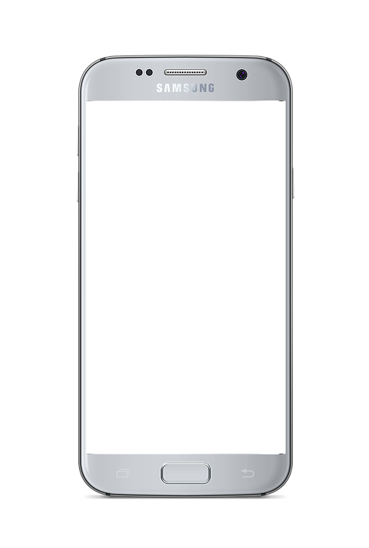
HoopFinder
Username
Password
Confirm password
REGISTER

Slide 8
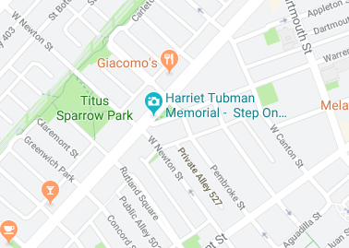


HoopFinder
MAP
FRIENDS
1 court near you!
3 ballers nearby

Slide 9
HoopFinder
MAP
FRIENDS
Friends
jumpinjack
speedsteve
hooper312
hgtwb88
ADD FRIENDS

